Slide 1

Dr Coleen Jackson
The role of municipalities in school improvement
Notes:
How the topic fits in with Time for leaders

Slide 2
Programme
What is the current context and what does the future look like?
What does research tell us about school leadership and supporting leaders?
The potential role of the municipality supporting schools

Slide 3

Many slides but the
session will involve discussion, co-constructing and sharing

Slide 4
The UK context of municipalities
Demise of LA
No power but responsibility
New ways of working
There is an important role
Do nothing or be proactive
SISSS and better outcomes for pupils

Slide 5
What does the future look like?
Information taken from 2003 – 13 Resolution; 2030 vision document and Education Law 2011
The 2030 strategy indicates that the current education system lacks flexibility (p 20) and underestimates the importance of critical thinking, creativity and pro-action (and innovation)
Notes:
Setting the context - From Lithuanian perspective a number of documents and laws have been discussed , consulted and written to indicate the direction of travel
Before we look into how municipalities can use a consultancy model to support schools and school leaders I want us to consider what the future might look like, the importance of leadership on student outcomes and what we know about activities that can transform practice

Slide 6
What does the future look like?
Developments in education should take into account the new challenges and opportunities for Lithuania as it make its contribution to the EU (p.3)
Preparing individuals for a knowledge society, a secure society and one that can compete economically (p1).

Slide 7
What does the future look like?
There is to be a focus on the independence of schools as learning communities and where the transparency of activity is ensured.
Strategic planning should be introduced at all levels (p 7) with a view towards community self-governance.
This should give increased openness and collaboration between schools and their communities.

Slide 8
What does the future look like?
Section 5 of the Education Law 2011 lays down 8 areas of responsibility of the school principal:
1) direct the drafting of a strategic plan and annual action plans of the educational institution
2) appoint and dismiss teachers, other persons involved in the education process
3) be responsible for making public the information

Slide 9
What does the future look like?
4) analyse the state of operational and management resources
5) perform other functions set out in the statutes of the school
6) together with the school council, decide whether or not to permit to install mobile communication stations on the school buildings

Slide 10
What does the future look like?
7) impose on a learner the disciplinary reformative sanctions
8) address the director of the municipal administration regarding the assignment of minimum and moderate supervision measures to a child

Slide 11
EU Presidency
An expense or an opportunity?
Spotlight on Lithuania – raised profile
Not just what you say you do but what you actually do
Use your presidency wisely, be proactive

Slide 12

So what do we need to change in our practice as we work with schools?
As Department for Regional Policy or Inspectors with a QA role

Slide 13

Plenary

Slide 14


Leadership for Change
Notes:
What we know is that the government feels that schools are inflexible to take on new initiatives; school leaders is not respond to change fast enough etc etc. As in Vision 2030 and 2003 – 12 Resolution states

Slide 15
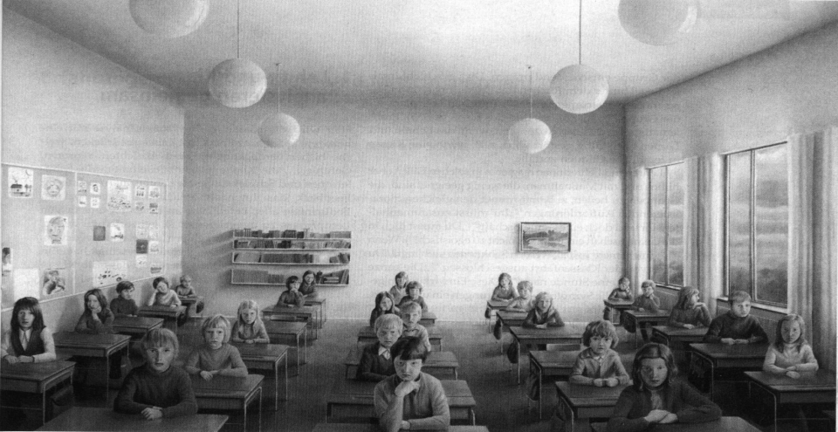

In school variance and between school variation
Better outcomes for students
Notes:
Stress ultimately we want better outcomes for students
What we do know is this needs a focus on in school variance and between school variation

Slide 16
Learning that transforms practice
From 2030 vision and 2003-12 Resolution
For all future professionals there is an emphasis on advanced skills
There should be new initiatives in the training and development of teachers (p 14).
Those development programmes should unlock learners’ potential and talent and include self-assessment and ensure the competence to undertake the role
Notes:
Skills for the future
Project management. Change management; how to work with external support?

Slide 17
Learning that transforms practice
The development of professional development processes
Activities we know support significant change
Notes:
The development of professional development processes – shift from one day wonders to developments that are sustained over time
Activities we know support significant change – shallow, deep, profound – self reflection, feedback, questioning

Slide 18
The importance of school leaders
Some noteworthy research claims that that school leadership is second only to teaching in its impact on student outcomes
How does a school system with poor performance becomes good? and how does one with good performance become excellent?
Consideration of the impact of different types of leadership on student outcomes
(Leithwood et al;2004, Day et al:2010, Robinson:2008 and 2009, McKinsey and Company research (2010)

Slide 19
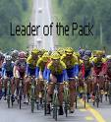
A change in leadership for successful change
Transactional leadership
Transformational leadership
Transactional leaders achieve performance as merely required by the use of contingent rewards or negative feedback
building a compelling vision of a better future underpinned by high moral confidence
establishing shared organisational goals
displaying high levels of interpersonal engagement with a deep understanding of personal, team and organisational learning
offering individualised support;
modelling best practices and important organisational values
demonstrating expectations of high performance
providing intellectual stimulation for others and seeking best practices
creating a productive culture with a commitment to community
developing structures to foster participation in decision-making and distributing leadership throughout the organisation
personal resilience.

Slide 20
So managers work with what has worked before (certainty) and leaders are looking for innovative solutions to new problems (uncertainty).
If you just continue to do what you have always done you will continue to get the same results

Slide 21
Increasing mental complexity links to ‘Development’…
Development:
Transforming the way of thinking
Training:
Adding new information to an existing way of thinking
C
A
TRANSFORM
How we know
A
B
INFORM
What we know

Slide 22
What do we know about ourselves?
Skill
Knowledge
Self-concept
Social role
Self-image
Trait
Motive

Slide 23

Model of Change
Notes:
In supporting school leaders and leadership in teams to make the changes they need in the future what kind of support might they need? What is the missing piece(s)
Flipchart with division down the centre:
Before they are appointed
When they are appointed

Slide 24
What is consultancy?
Resource Process
Consultancy Consultancy
Expert approach Facilitative approach
Notes:
The power of questioning
A more coaching approach
Building the skill capacity

Slide 25

Activity
To prepare municipalities what skills are needed when working as process consultants?
To prepare school leadership what do they need to do before
working with someone
who uses process
consultancy skills?
Notes:
Either in groups answering both questions or
Divide the room into four groups – two groups take one question (AB and CD) – once completed they share with the other group who answered the same question – draw out key points
A then share with C and B shares with D

Slide 26
Plenary

Slide 27
The role of the municipality in supporting schools
The purpose of the municipalities is to work with government and support schools.
How they work with schools moving forward will be important to ensure they have a substantial role in school improvement and development.

Slide 28
The Strategic Triangle
Legitimate & Politically
sustainable
Authorising
Environment
Stakeholder
Value
Proposition
Operationally &
Administratively feasible
Operating
Capacity
Substantively
valuable
Notes:
The role of municipalities in how they work within their community
Authorising environment
What do I mean by the term ‘authorising environment’ and why is it a useful concept? The term as I am using it here was coined by Mark Moore in his influential 1995 book ‘Creating Public Value’. For Moore, Public Value is determined by concepts held at the institutional and individual level which are informed by assumptions about what constitutes value in the wider public arena. In a democracy, authorisation of what is to be considered as publicly valuable is determined by the political process. Political management, what Moore calls ‘management of the authorising environment’ is therefore key to securing Public Value. The ‘authorising environment’ consists of a range of functions which I have summarised as follows:Routine accountability: Reporting through channels of accountability the activities of the enterprise or service, examples being standard audit, accounting, scrutiny and public reporting routes.Authorisation of change and innovation: Brokering understanding and ownership of the need to change the ‘mix’ of Public Values produced by the organisation arising from differing concepts of Public Value. An example of this would be the change authorised by the public through the 2010 UK General Election.Achieving inter-agency cooperation: Liaising on common ground for action or achieving indirect pressure for change through influence and identification of forces and pressures on partner organisations and their political frameworks. A good example right now would be what was ‘Total Place’ and is rapidly becoming ‘Community Based Budgeting’.Mobilising stakeholders, citizens and customers: Making real their authority to act through a process of broader authorisation using what Moore called ‘decentralised co-production’. This is ‘Big Society’ expressed in 1995 policy term
Stakeholder Value Proposition - Purpose – The value proposition concept and the stakeholder perspective have received relatively little attention within Service-Dominant (S-D) logic. This paper sets out to explore value propositions in the context of S-D logic, within the multiple stakeholder domains that form part of a marketing system. Its purpose is to identify how use of the value proposition concept, in this broader context, provides new insight into value creation within a value network.Design/methodology/approach – This paper explores the development of value propositions in key stakeholder market domains. A five-step process is developed for identifying key stakeholders and co-creating value propositions for them within a marketing system.Findings – Value propositions have a key role in co-creation of value between stakeholders. The development of value propositions in multiple stakeholder domains can provide an important mechanism for aligning value within a marketing system.Practical implications – Stakeholder value propositions provide enhanced opportunities for value co-creation and can assist managers in aligning value and stabilizing relationships within an organization's value network.Originality/value – This paper considers a broader view of value through creation of value propositions for key stakeholders. An iterative framework is proposed that couples the stakeholder concept and value co-creation.
Purpose – The value proposition concept and the stakeholder perspective have received relatively little attention within Service-Dominant (S-D) logic. This paper sets out to explore value propositions in the context of S-D logic, within the multiple stakeholder domains that form part of a marketing system. Its purpose is to identify how use of the value proposition concept, in this broader context, provides new insight into value creation within a value network.Design/methodology/approach – This paper explores the development of value propositions in key stakeholder market domains. A five-step process is developed for identifying key stakeholders and co-creating value propositions for them within a marketing system.Findings – Value propositions have a key role in co-creation of value between stakeholders. The development of value propositions in multiple stakeholder domains can provide an important mechanism for aligning value within a marketing system.Practical implications – Stakeholder value propositions provide enhanced opportunities for value co-creation and can assist managers in aligning value and stabilizing relationships within an organization's value network.Originality/value – This paper considers a broader view of value through creation of value propositions for key stakeholders. An iterative framework is proposed that couples the stakeholder concept and value co-creation.

Slide 29
Three Key Questions
The Strategic Triangle – Mark Moore
Is it administratively and operational possible?
Is it politically and legally possible?
Is the purpose stakeholder valuable?
Three Key Activities
Managing downward towards improving the operating capacity for achieving the desired purpose.
Managing upward, towards politics, to get or maintain legitimacy and support for that purpose
Judging the value of your imagined purpose
Moore M H (1995) Creating Public Value, Cambridge, Massachusetts: Harvard University Press.

Slide 30
Problems, Problems, Problems (Keith Grint)
PROBLEM
Wicked
Tame
Crisis
RESPONSE
Leadership
Management
Command
WORK / OBJECTIVE
Trial & Error
  To make Progress
Research & Development
  To identify and design a Fix
Command & Control
  To restore normality (order)
-asking good questions
- Managing the best process
- Providing an answer
Notes:
Helping schools to see the kinds of problems that they face

Slide 31
“The single biggest failure of leadership is to treat adaptive challenges like technical problems”
Heifetz and Linsky, Cambridge Leadership Associates, www.cambridge-lead
ership.com/
Adaptive Leadership

Slide 32
Wicked Problems
More complex (rather than complicated). Cannot remove the problem from its environment, solved and return without affecting the environment.
There may be no clear relationship between cause and effect.
Such problems often intractable e.g. inclusion and distribution of resources (Equality V Equity).
Many educational problems are highly complex e.g. underachievement – ability, family, teachers, peers, health, diet, ? ? ? ? ?
There are no “stopping points” with Wicked problems.

Slide 33
Wicked Problems
Wicked problems need collective solutions (participation)
‘Solving wicked problems is an art rather than a science’ Chinese Emperor Liu Bang (3rd century)

Slide 34
Elegant approaches do not solve wicked problems but Clumsy solutions might
Elegant = rational, and often internally consistent
Clumsy solutions need the “BRICOLEUR” (do-it-yourself craft worker). Kant “out of the crooked timber of humanity no straight thing was ever made”. Accept imperfection, make do with what is available, progress does not depend on consensus (take too long). Start with what do most of us agree on? Avoid alienating significant constituencies

Slide 35
What would be a valuable support role for municipalities in the future?
They could do more of….
They could do less of…..

Slide 36

Conclusions

Slide 37
“Some problems are so complex (in education) that you have to be highly intelligent and well informed just to be undecided about them”
Laurence J Peter

